Slide 1
Unclogging a Cement Silo
6.4.24 version 1.0

Slide 2
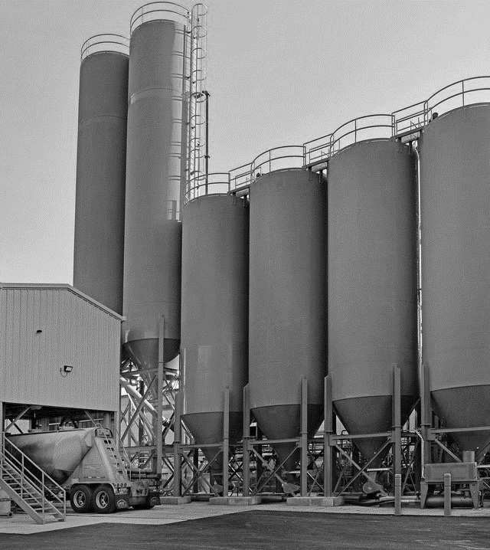
Assumptions and Prerequisite Skills
The computer is on and IntelliBatch 3.0 is open
Supplies Needed
Standard PPE
Mallet

Slide 3
Procedure
1. Before you begin checking for a clogged bin, make sure to visually confirm the bin is not empty. You can tell this by monitoring the vertical blue line next to each bin (Red circle in Figure 1). If the bottom light on the right of a bin lights up, this means that the bin is almost, if not completely, empty.
Figure 1

Slide 4
Procedure
2. Two signs that a silo is clogged:
A silo is red and the valve icon (Figure 2) remains at a vertical position for an extended period of time
You get an error message at the bottom of the screen (Figure 3)
Figure 2
Figure 3

Slide 5
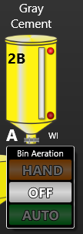
Procedure
3. If conditions (a and b) have been met, click on the A icon underneath the corresponding silo (Figure 4).
Figure 4

Slide 6
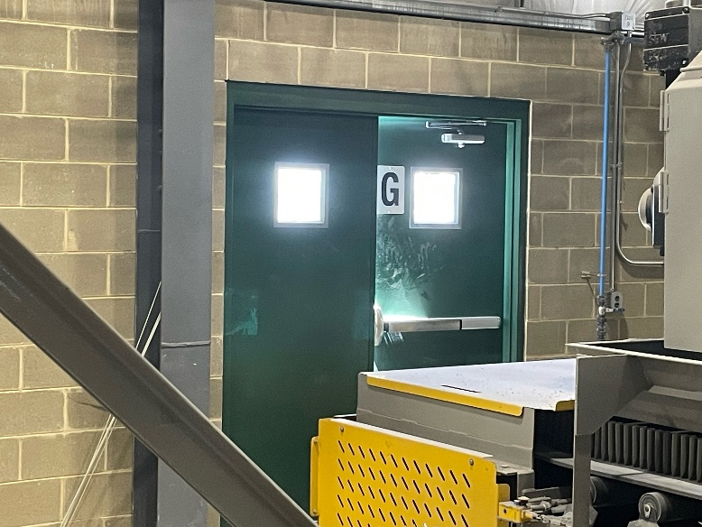
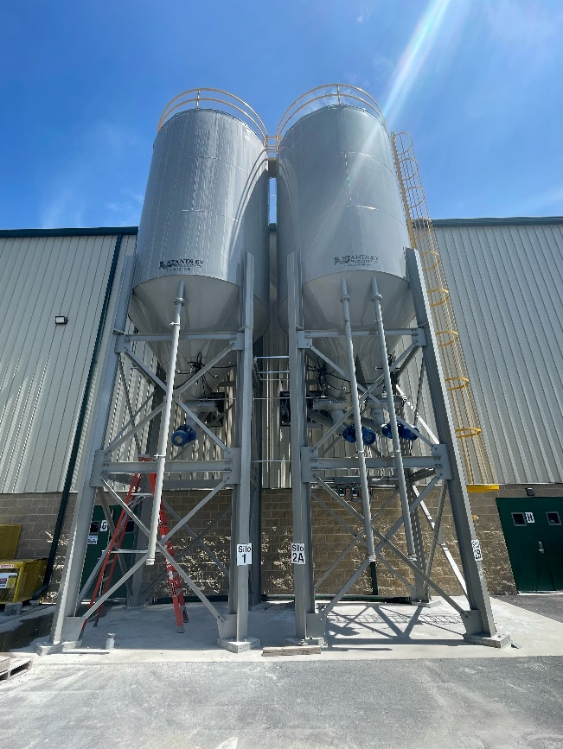
Procedure
4. If the bin seems to be ejecting aggregate normally, you are finished. If there does not seem to be any change to the condition, proceed to the silos (see Figure 5B). These can be found by taking the “G” Exit (Figure 5A).
Figure 5A
Figure 5B

Slide 7
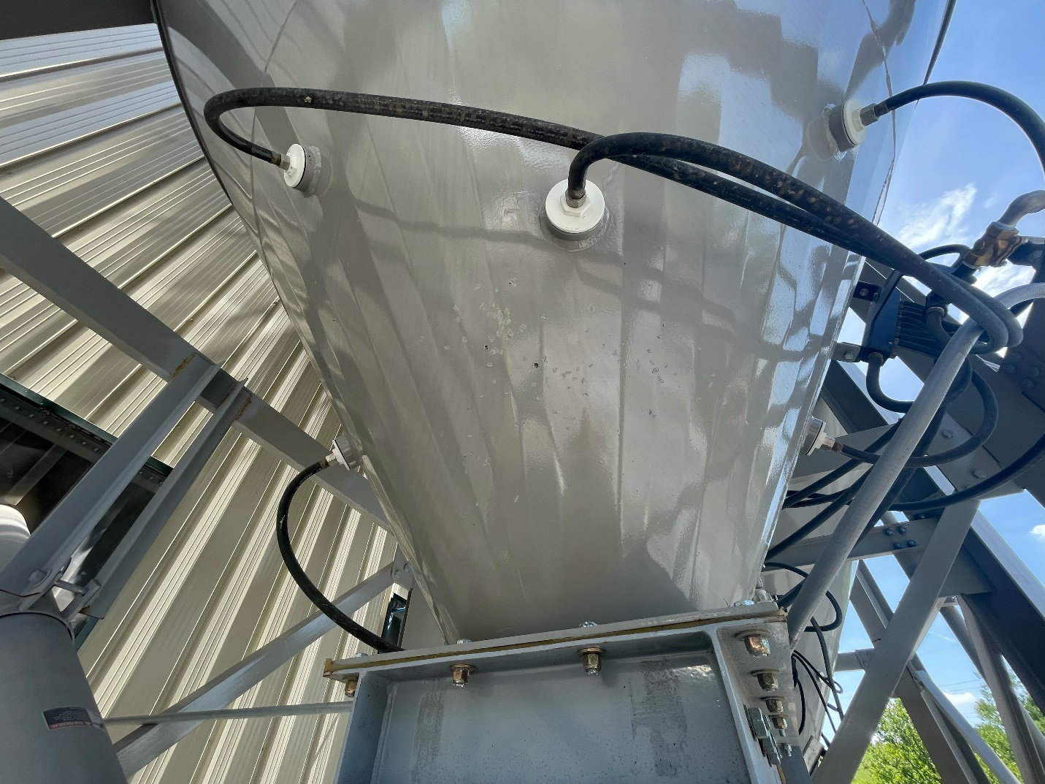
Procedure
5. Set up a ladder and repeatedly strike both sides of the bin in the yellow shaded area with a sledgehammer (Figure 6).
6. Go back and check if the silo icon is still red. If it is, repeat steps 5 and 6.
Figure 6

